Slide 1
Talent Management Solutions to Prevent Employee Attrition
Zwei Group from DDSAnalytics
Elisabet Zidow, Jonathan Franks, Shanqing Gu
GitHub address: github.com/guvp2017/DDS_CaseStudy2.git

Slide 2
Introduction
Employee turnover (attrition) is the reduction of staff by voluntary or involuntary reasons. This is never good for business.
Can we predict which employee is going to leave next month? Can we keep employee for longer time with a bonus program or promotion? Our DDSAnalytics is specialized in providing talent management solutions to these questions
With the given data (1,470 observations and 35 variables), we have identified answers to the following questions:
What are the top factors that contribute to turnover?
How about the job role specific trends?
What about other interesting trends and observations?

Slide 3
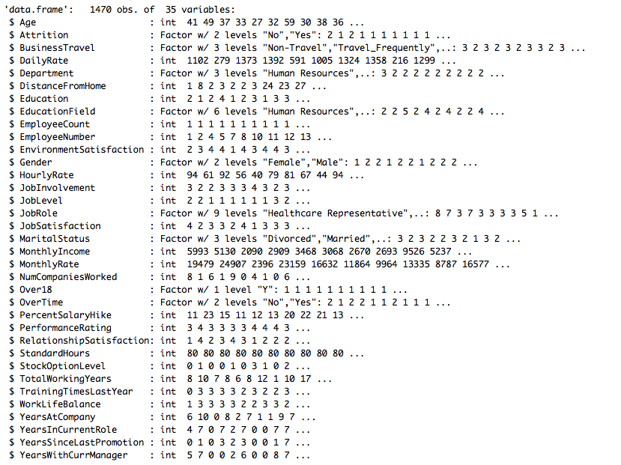
Q1: What are the top factors that contribute to turnover?
Exploratory Data Analysis (EDA)
There are 1470 observations with 35 variables in this quite heavily imbalanced dataset which will be noted further in model prediction.
No Missing data (NA).
For variables EmployeeCount, Over18 and StandardHours, they have one unique values as checked by nearZeroVar function
Binary responsible variable Attrition

Slide 4
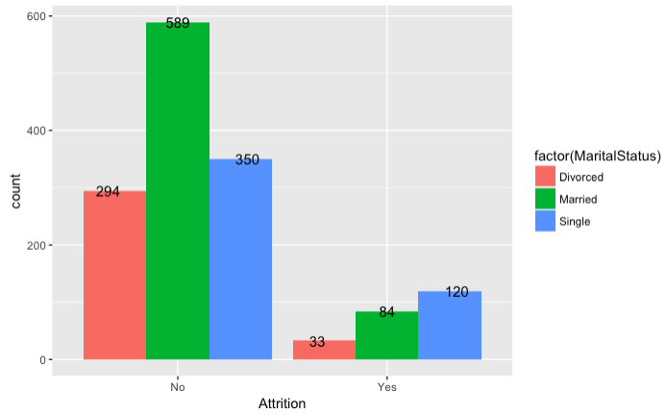
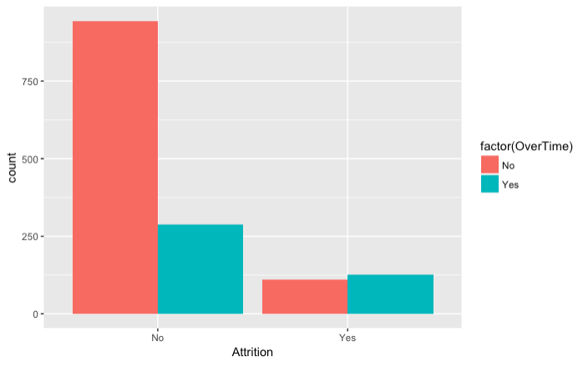
Q1: What are the top factors that contribute to turnover?
Exploratory Data Analysis:
EDA Top Drivers:
Marital Status (Single)
Working Over Time
Hypothesized Drivers:
Business Travel (Frequent),
Job Role (Sales)
Education Field (Tech degrees)
Martial Status (Single)
Singles are more likely to leave than married
(Blue)
Y-axis: Attrition
X-axis: Marital Status
Working Over Time
Working Over Time are more likely to leave
(Teal)
Y-axis: Attrition
X-axis OverTime

Slide 5
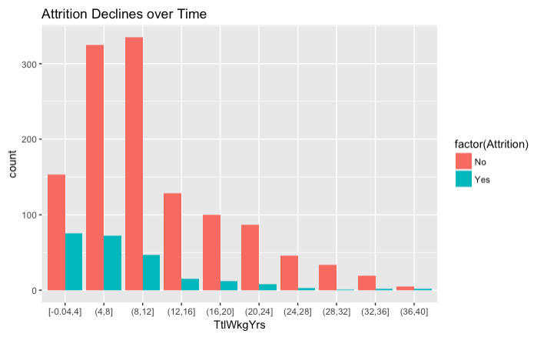
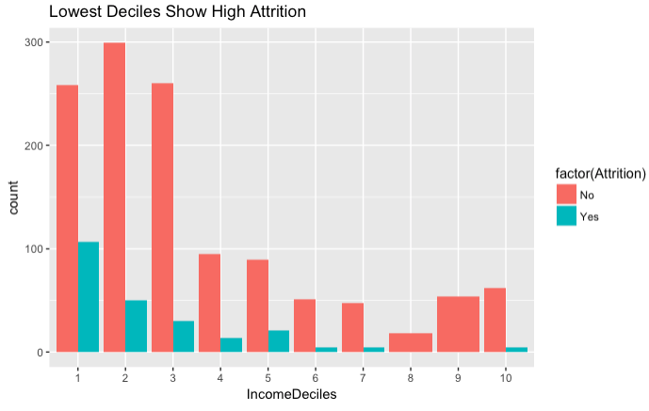
Q1: What are the top factors that contribute to turnover?
Years of Service (Deciles)
Significant Attrition that decreases as total working years increases.
Attrition is highest in groups with less than 8 total working years and then decreases.
Income (Deciles)
Significant Attrition that decreases as Income increases.
Top 8th and 9th income deciles report zero attrition.
For continuous variables it is helpful to view them in bins, or deciles, in order to see a discrete pattern.

Slide 6
Q1: What are the top factors that contribute to turnover?
Model Testing For Best Fit and Factor Identification
Goal: Predict binary response variable of attrition and learn more about the driving factors for attrition with each model.
Algorithm Models Selected:
Linear methods: Generalized Logistic Regression (GLM)
LASSO
Non-Linear methods: Neural Network
Trees and Rules: CART
Ensembles of Trees: Random Forest

Slide 7
Model Performance By Accuracy
Q1: What are the top factors that contribute to turnover?
1. Random Forrest Model: Accuracy 0.88 modelRf = randomForest(Attrition ~ ., data=train, ntree = 100, mtry = 5, importance = TRUE, method="class")
2. Generalized Linear Regression Model: Accuracy 0.89 cs2.glm <- glm(formula = Attrition ~., family="binomial" , data=cs2[, -c(9, 22, 27)])
3. Tree and Rules Model: Accuracy 0.84 modelCart = rpart(train$Attrition ~ ., data=train, method="class")
4. LASSO: Accuracy 0.84 cvfit <- cv.glmnet(x, y, family = "binomial", type.measure = "class", nlambda=200) (lasso)
5. Neural Network Model: Accuracy 0.81 model_2 <- neuralnet(f, data = train, hidden=33, act.fct="logistic", linear.output=FALSE,lifesign="minimal")

Slide 8
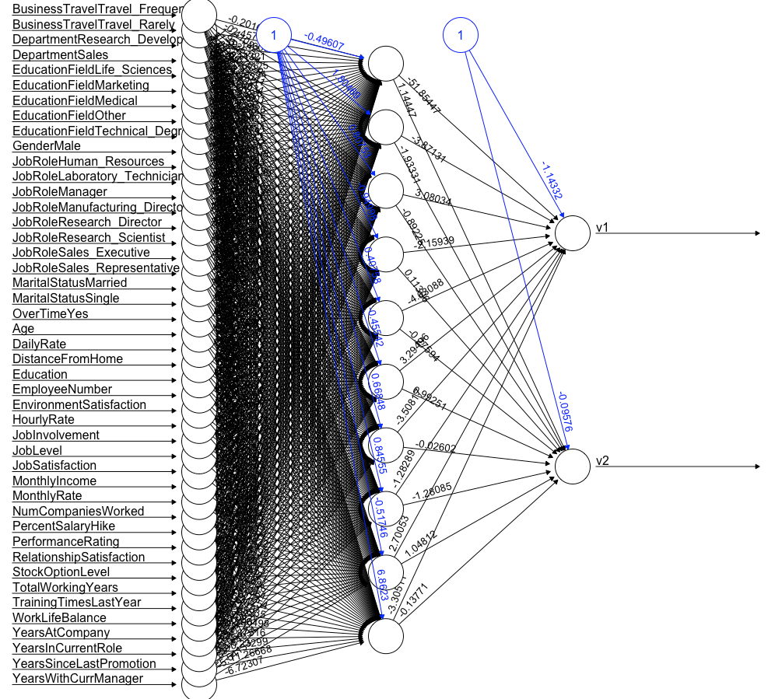
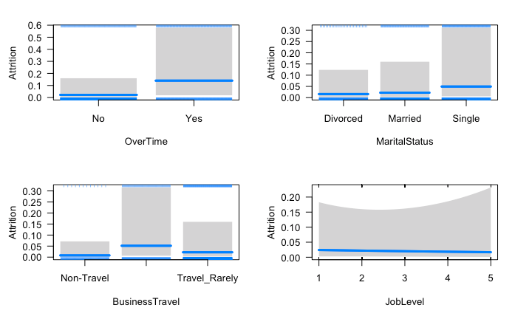
Q1: What are the top factors that contribute to turnover?
Generalized Linear Model:
Accuracy 0.89
Top Factors:
Over Time
Marital Status
Business Travel
Job Level
Neural Network Model: Accuracy 0.81

Slide 9
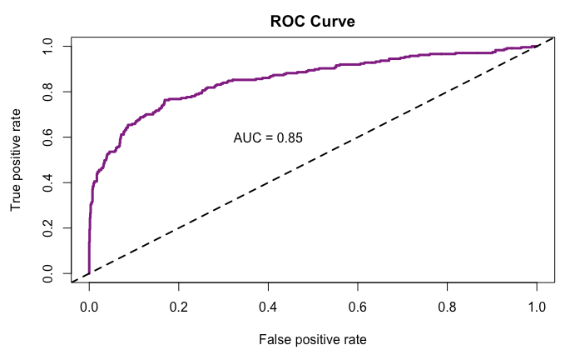
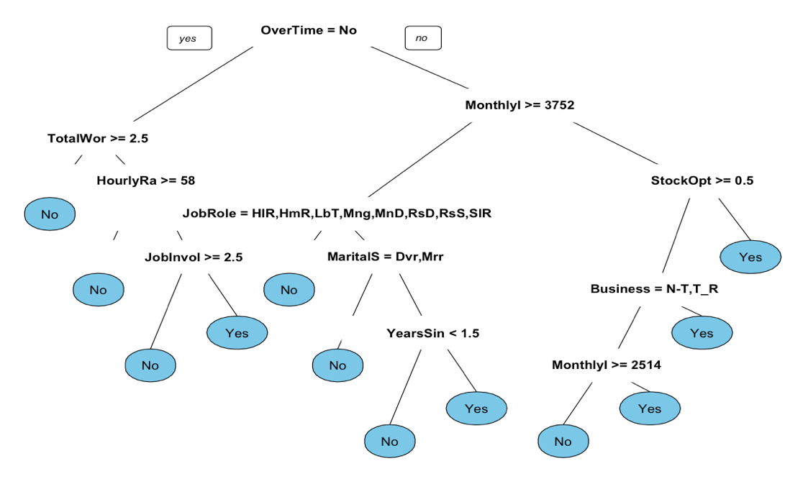
Q1: What are the top factors that contribute to turnover?
The LASSO Model: Accuracy 0.84
Top Factors:
Over Time (Yes)
Business Travel(Travel Frequently)
Martial Status (Single)
Job Role (Sales Representative)
Education Field(Technical Degree)
Classification and Regression Trees
(CART) Model: Accuracy 0.84
Top Factors:
Over Time (Yes)
Total Working Years (Less than 2.5yrs)
Income (Less than 3,752 monthly)

Slide 10
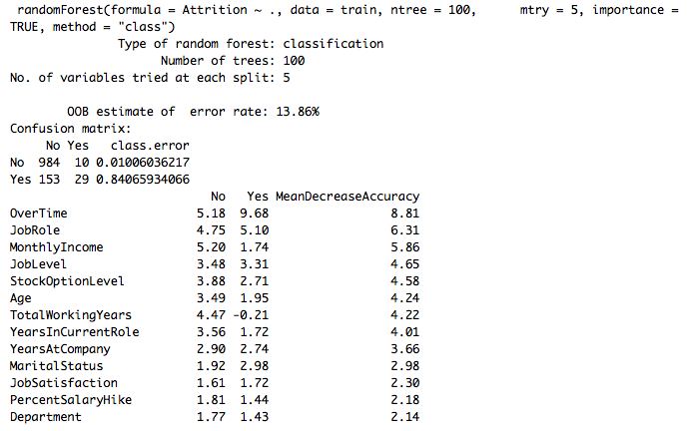
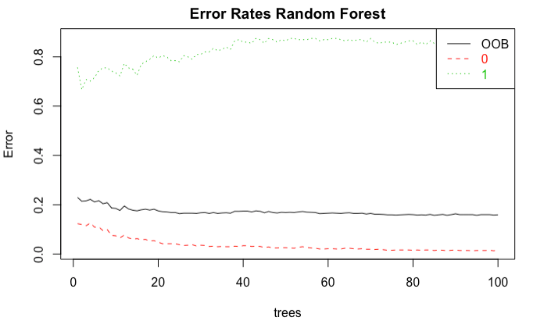
Q1: What are the top factors that contribute to turnover?
Random Forest Model: Error rate: 0.1386, Accuracy: 0.88
Top Factors:
Over Time
Job Role
Income
Job Level
Stock Option Level
Note: Martial Status & Frequent Travel don’t weight highly in the Random Forest Model.

Slide 11
Q1: Summarization of Important Attributes
Strong Factors in all 4 models:
Over Time
Strong Factors for 2 out of 4 models:
Business Travel
Marital Status (Single)
Job Role (Sales)
Age
Monthly Income
Strong Factors in 1 out of 4 models:
Education Field
Total Years Worked

Slide 12
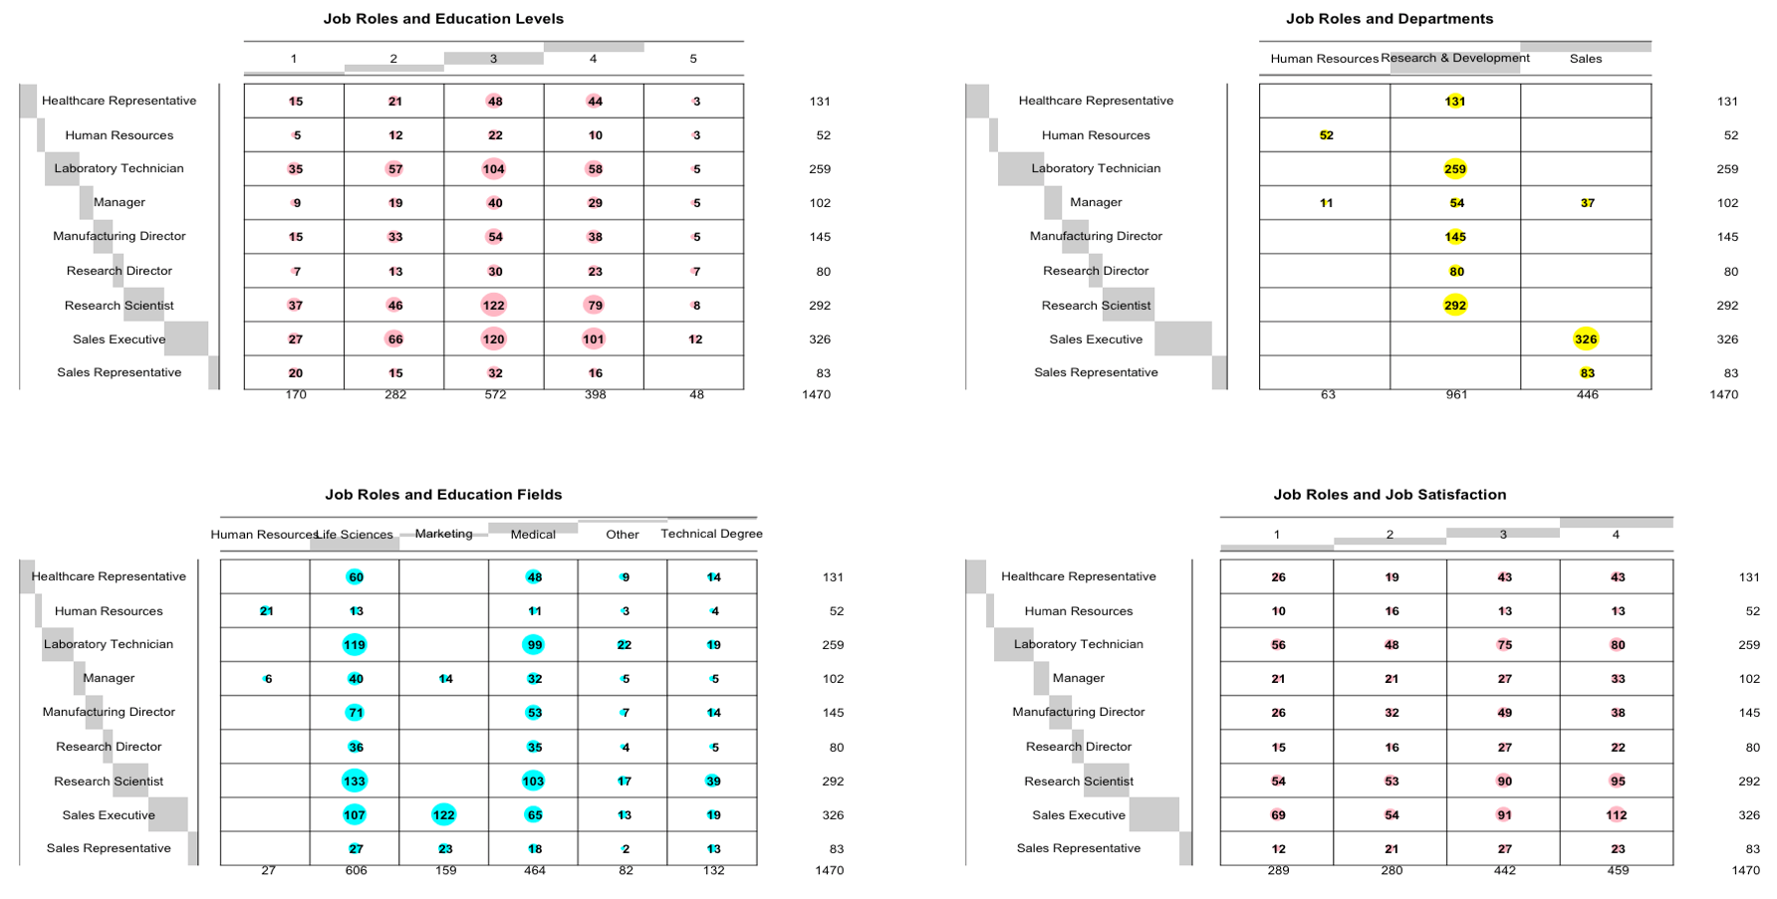
Q2: How about the job role specific trends?

Slide 13
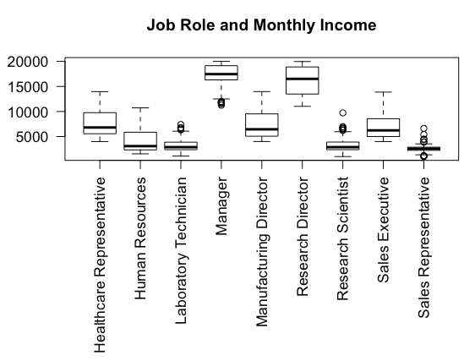
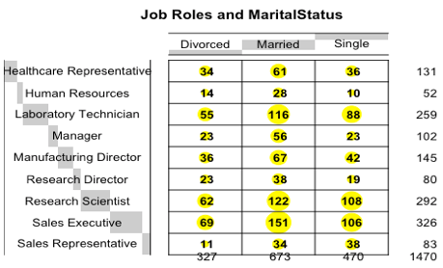
Q2: How about the job role specific trends?
From the contingency tables and the box plots shown above, there are interesting trends related to job roles:
Research Scientist and Sales Executive have better education;
Research Scientists work mainly in R&D Departments, while Sales Executives in Sales Department;
Research Scientists and Sales Executives work mainly in life science and medical fields;
Both populations are highly married and very satisfied with their jobs;
Their monthly incomes are relatively less than mangers and research directors.

Slide 14
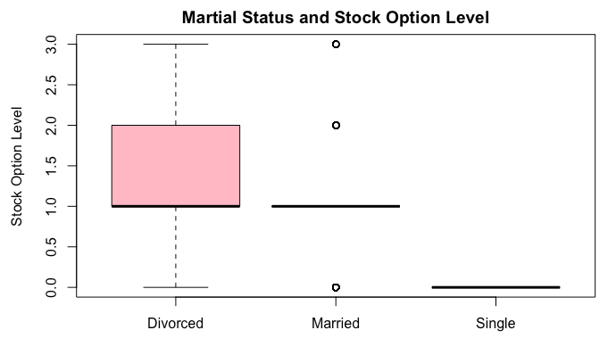
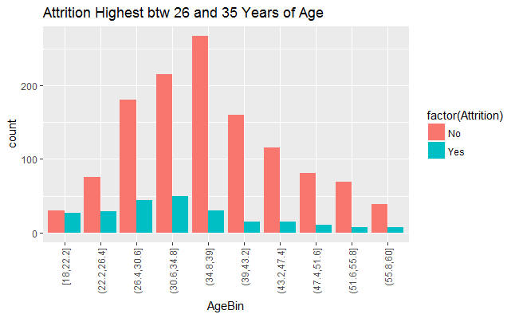
Q3: What about other interesting trends and observations?
Stock Option Level Inequality:
Appearing as a risk factor in modeling may indicate this is a weak point that needs higher level review by the company.
Divorced employees only account for 22% of the population.
Employee Age:
Employees between 26 and 35 years of age are at the highest risk for Attrition.
A possible plan to address this weak point are programs to aid the employees in that age group plan their careers in the next generation of leadership in the company.

Slide 15
Summary
Our analytics help you plan for turnover before it becomes a crisis by identifying and helping manage risk factors for attrition.
Where you are doing well: Both Research Scientists and Sales Executives tend to have better education, work mainly in life science and medical fields, and do well with their marriage and careers.
Profile of High Attrition Risk Employee:
Single, works overtime, travels frequently, Age 26-35.
Possible Points for Improvement:
Stock option levels are different among single, married, and divorced. This inequality may be a contributing factor for attrition.
DDSAnalytics Next Steps:
On Going Prediction Modeling
Regular Development of models to keep pace with new data and trends.
On Going Risk Factor Analysis
Regular Analysis of Risk Factors to identify weak points in employee retention.
Risk Factor Management
Creation of actionable plans to address the weak points identified in employee retention.

